Slide 1
Making Better Visualizations
with R and ggplot
Notes:
Introduce self

Slide 2
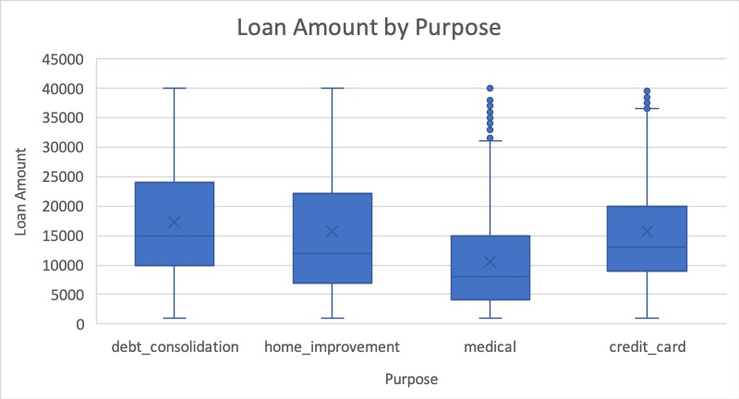
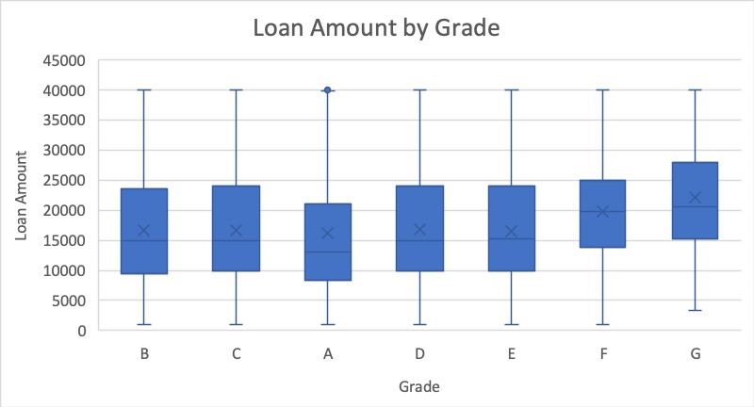
Today We Will…
Learn how to make these excel charts...

Slide 3
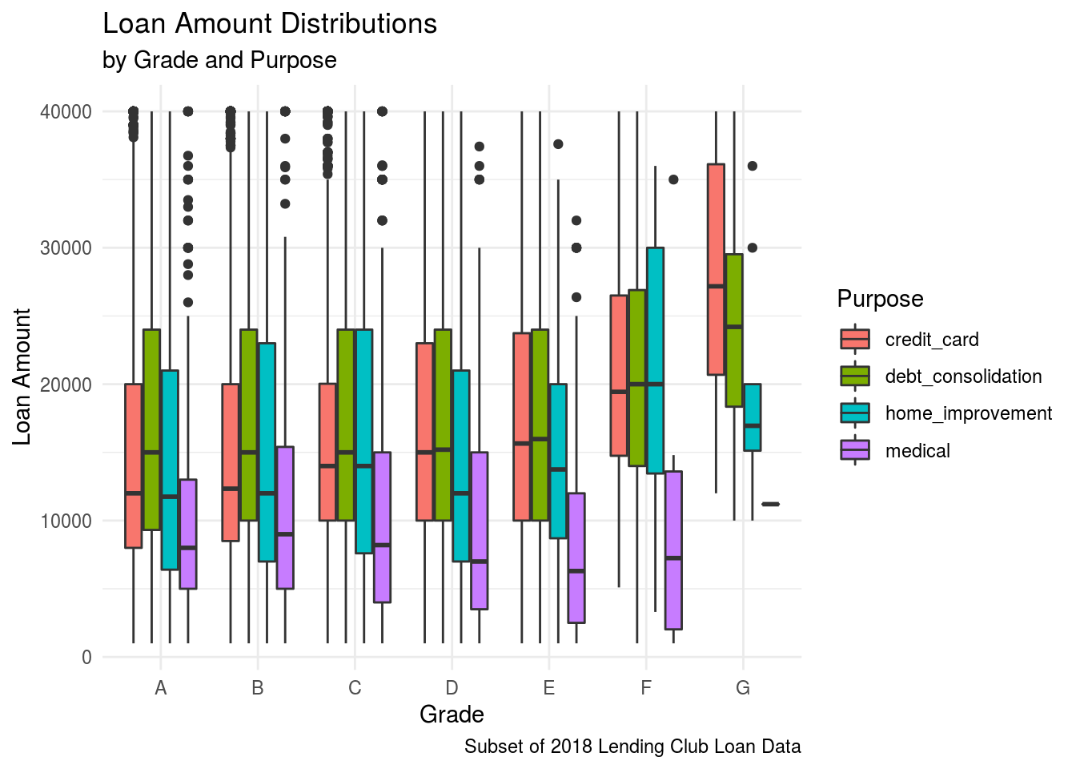
Today We Will…
but, combined, in R:
Notes:
Graphs like this are great in reports. Informative of loan amount by grade and purpose combined
Can't easily do in excel
2 min

Slide 4

Run Your First R Code
Go to this link: https://bit.ly/2AdohOQ
Sign in or create account
Join Space
Click "Projects" at the top
Select the "Loan Analysis" Project
Wait for project to deploy
Select "LoanDataAnalysis.Rmd" (bottom right)
Click "Knit" (top left, blue yarn ball icon)
Notes:
R is a programming language
You can program R in RStudio/RStudio Cloud
Name parts in RStudio
Knitting gets your results
2+4 = 6 Min

Slide 5
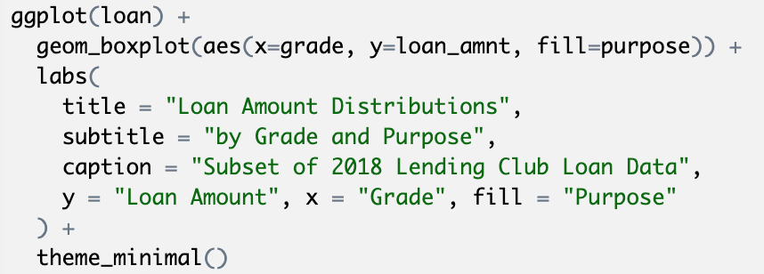
How did we do it?

Slide 6
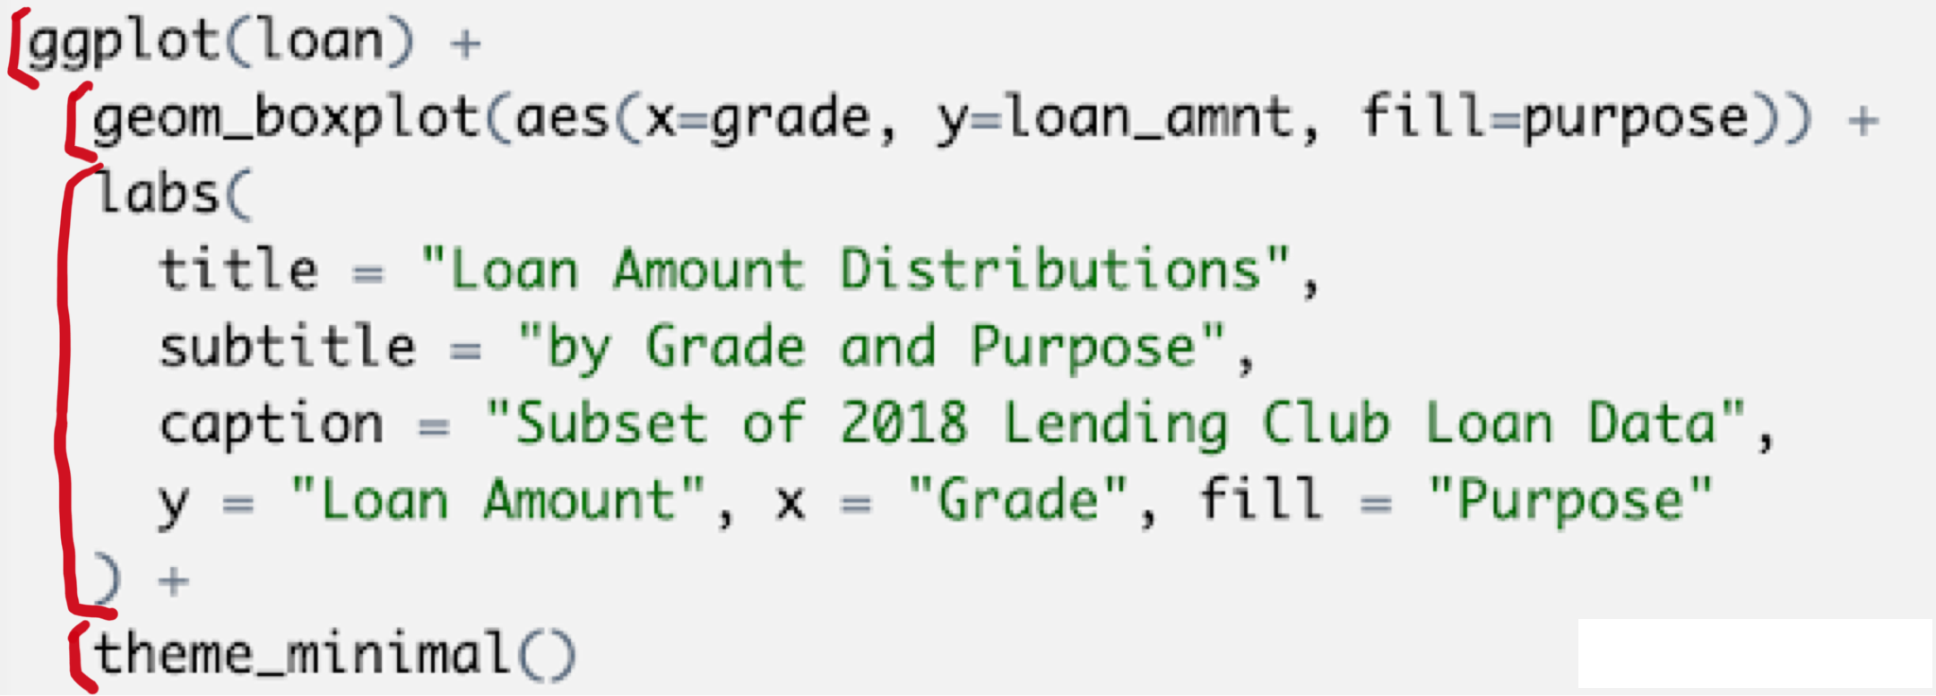
How did we do it?
Plots consist of layers
Notes:
Each line-ish is a layer

Slide 7
How did we do it?
Plots consist of layers
1st layer: Data
Notes:
2+4+1 = 7 Min

Slide 8

Your Turn
What happens when we only run ?
Remember: use "Knit" to run your code
Discuss with your neighbor. Why do you think this happens?
Notes:
2+4+1+3 = 10 Min

Slide 9
How did we do it?
Plots consist of layers
1st layer: Data
2nd layer: geom_function and aesthetic values
Notes:
This tells us our plot type, x axis, y axis, and sometimes a little more, like fill

Slide 10
How did we do it?
Plots consist of layers
1st layer: Data
2nd layer: geom_function and aesthetic values
These layers are connected with a "+"
Notes:
This tells us our plot type, x axis, y axis, and sometimes a little more, like fill
2+4+1+1 = 8 Min

Slide 11
How did we do it?
Plots consist of layers
1st layer: Data
2nd layer: geom_function and aesthetic values
The rest is extra
Notes:
2+4+1+1+2+1 = 11 Min

Slide 12
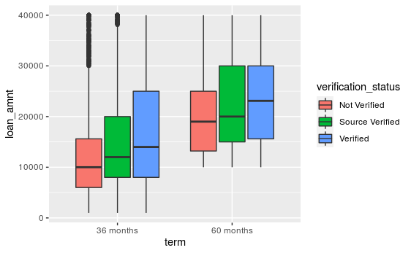

What code will correctly generate this graph?
a.
b.
c.
d.
Notes:
2+4+1+1+2 = 10 Min

Slide 13
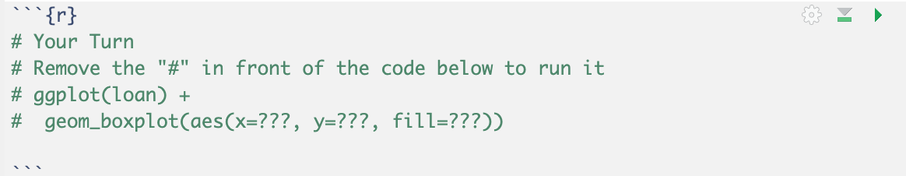
Your Turn
Make a boxplot with:
grade on the x-axis,
int_rate on the y-axis, and
home_ownership as fill
Use the lowest code block to do so
Remove the "#" in front of the code
Replace the "???" with the correct variable names
Discuss what you see with your neighbor
Notes:
2+4+1+1+2+1+3 = 14 Min

Slide 14
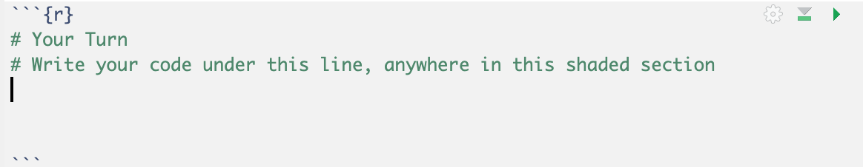
Your Turn
Make a boxplot with:
grade on the x-axis,
int_rate on the y-axis, and
home_ownership as fill
Use the lowest code block to do so
Discuss what you see with your neighbor
Notes:
2+4+1+1+2+1+3 = 14 Min

Slide 15
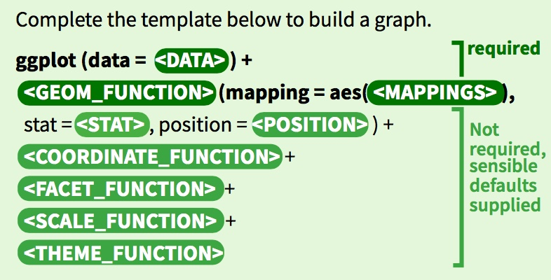
You Can Make Any Graph with This Formula

Slide 16
You Can Make Any Graph with This Formula

Slide 17
Further Resources
Getting started with R: https://rstudio.cloud/learn/primers
ggplot Cheatsheet: https://ggplot2.tidyverse.org/#cheatsheet
R for Data Science Book: https://r4ds.had.co.nz/
Top 50 ggplot Visualizations: http://r-statistics.co/Top50-Ggplot2-Visualizations-MasterList-R-Code.html

